Slide 1
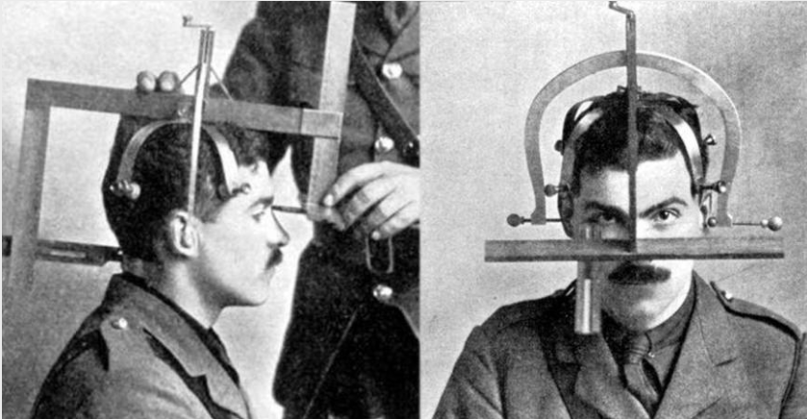
Science or Just Racism
Eric Prebys
FRS-003-009

Slide 2
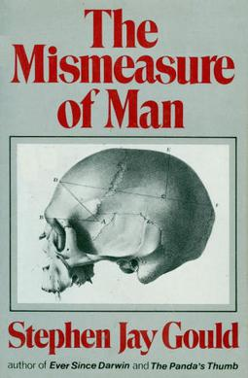
The Mismeasure of Man
Stephen Jay Gould’s, “The Mismeasure of Man” is considered the seminal work on this topic.
I draw heavily from it in this lecture
Anything I don’t explicitly link to probably came from this book.
Another excellent book by Stephen Jay Gould is “Ever Since Darwin”

Slide 3
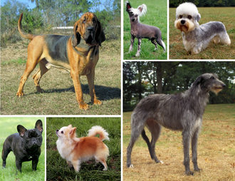
Racism and Classism
There is no scientific definition of “race”
It’s believed that the human race was reduced to about 1200 individuals around 900,000 years ago.
As a consequence, humans are one of the most genetically homogenous species on Earth
99.9% common DNA
The term race is colloquially assigned to groups with cosmetic differences, owing to historical geographic separation.
It is presently accepted to be primarily a social construct.
Therefore, there’s no real difference between “racism” and “classism” – the belief the certain socioeconomic classes are inherently superior to others.
I’ll use the terms interchangeably.
Of course, similar methodology has been applied to sexism.
Compare to dogs

Slide 4
Born on Third Base and Call it a Triple
Since the beginning of recorded history, the people at the top of whatever the local power structure is have looked for reasons to justify and legitimize their position there
Historically, these arguments have generally involved the intervention of some deity or deities. Examples…
Ancient Egyptians
Greeks and Romans.
Aztec Empire
British Empire
In the last couple of centuries, people have increasingly turned to “science” to build their case, but it usually comes back to the same thing:
The people at the top deserve to be there!
I don’t think anyone has ever reached the conclusion that their personal group are the inferior ones!

Slide 5
Reification
Reification is the fallacy of treating something that is not concrete as a concrete thing.
In our context, we use it to refer to the attempt to “rank” humans on a linear scale, from “inferior” to “superior”.
The most obvious example is the concept of “intelligence”, as measure by IQ, or any other single number. In fact the brain can excel in very different ways.
Mathematics
Music
Hand/eye coordination.
Language
Artistic ability
etc
We’ll get back to that shortly..

Slide 6
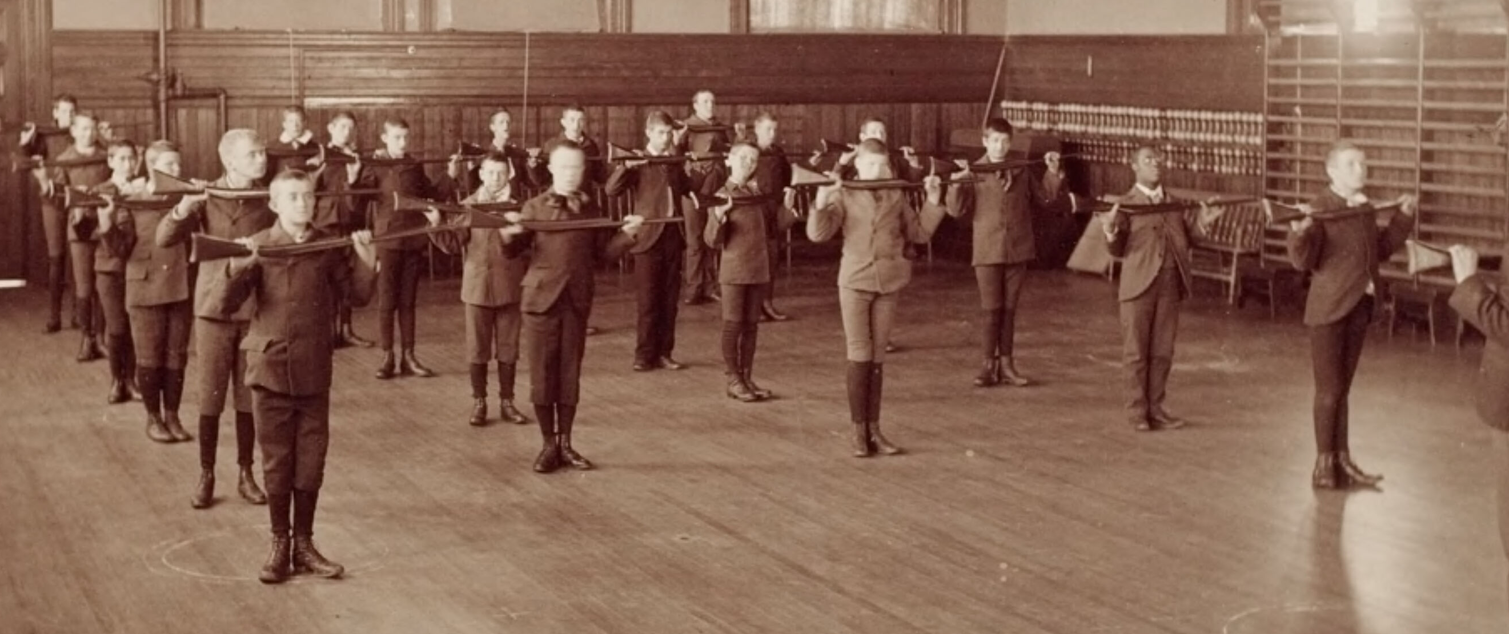
“Feeblemindedness”
This term kept coming up again and again as I was preparing this lecture.
For example, in the late 19th and early 20th Century, there were many, many “schools for the feebleminded”.
I realized I wasn’t sure what it meant.
In 1908, the definition adopted by the British government's Royal Commission on the Care and Control of the Feeble-Minded was:
“[P]ersons who may be capable of earning a living under favourable circumstances, but are incapable from mental defect, existing from birth or from an early age: (1) of competing on equal terms with their normal fellows, or (2) of managing themselves and their affairs with ordinary prudence.”
It’s important to realize that this definition could (and did!) include many people who are socioeconimically disadvantaged, with no actual mental deficiencies.
For example, it was very common to declare prostitutes “feebleminded”.
“Feebleminded” learning to use guns at the Massachusetts School for the Feeble-minded (1903).

Slide 7
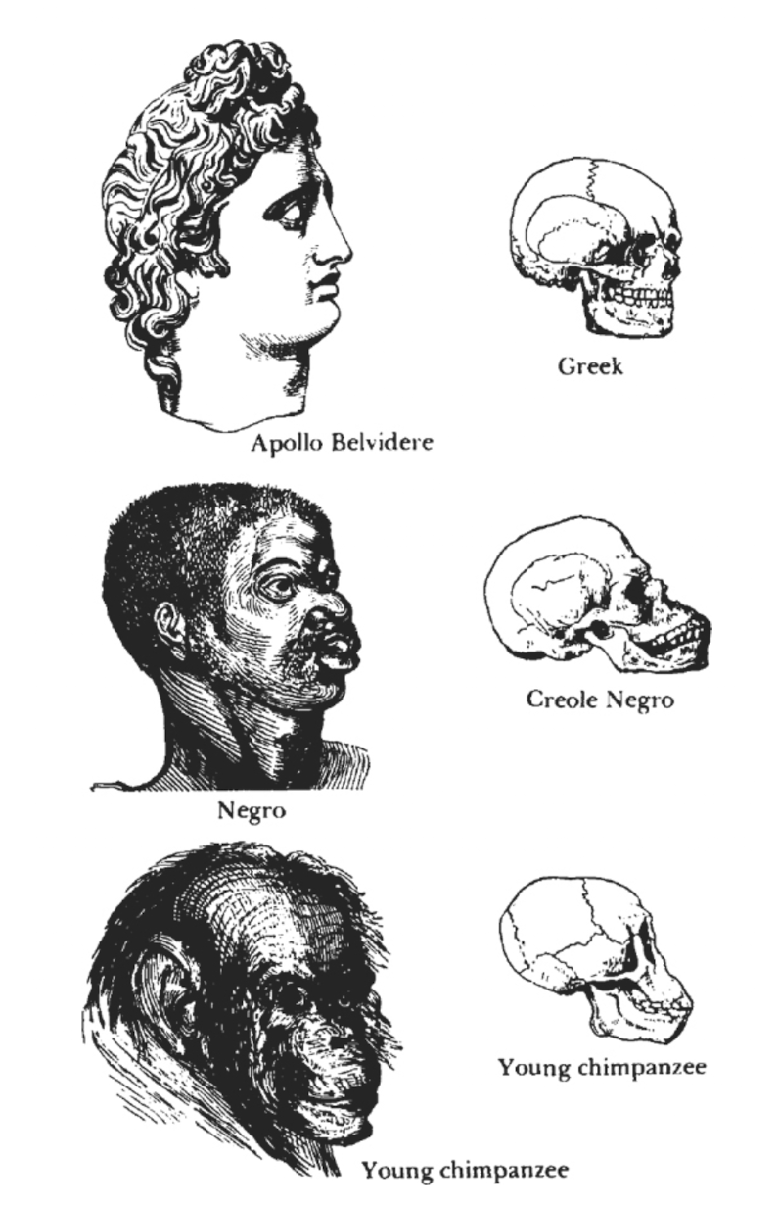
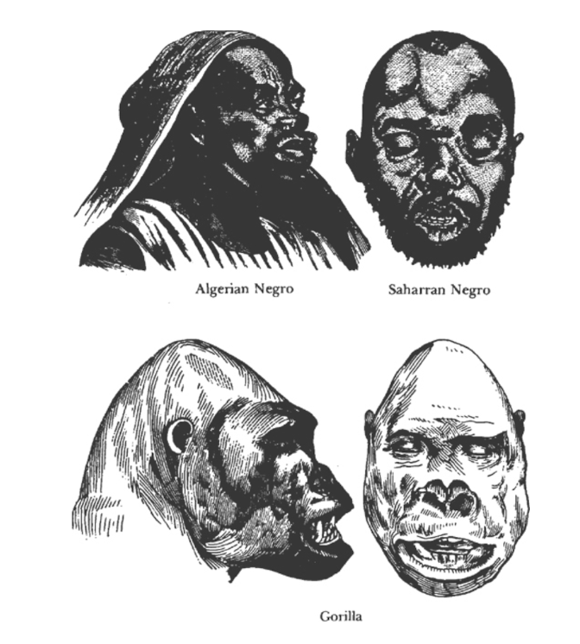
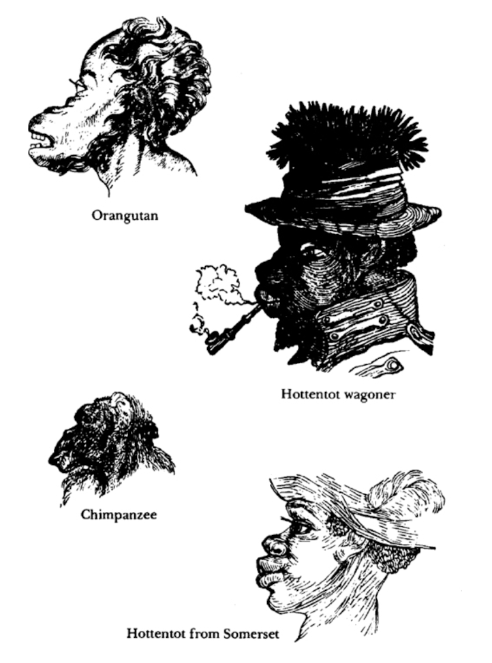
Pre-Darwin Human Taxonomy
It’s fair to say that a lot of of people of European descent took the “natural order” of human races to be axiomatic.
To quote the Great Emancipator, Abraham Lincoln:
“There is a physical difference between the white and black races which I believe will forever forbid the two races living together on terms of social and political equality. […] I as much as any other man am in favor of having the superior position assigned to the white race.”
People generally took these prejudices as inputs and then went looking for data to support them.

Slide 8
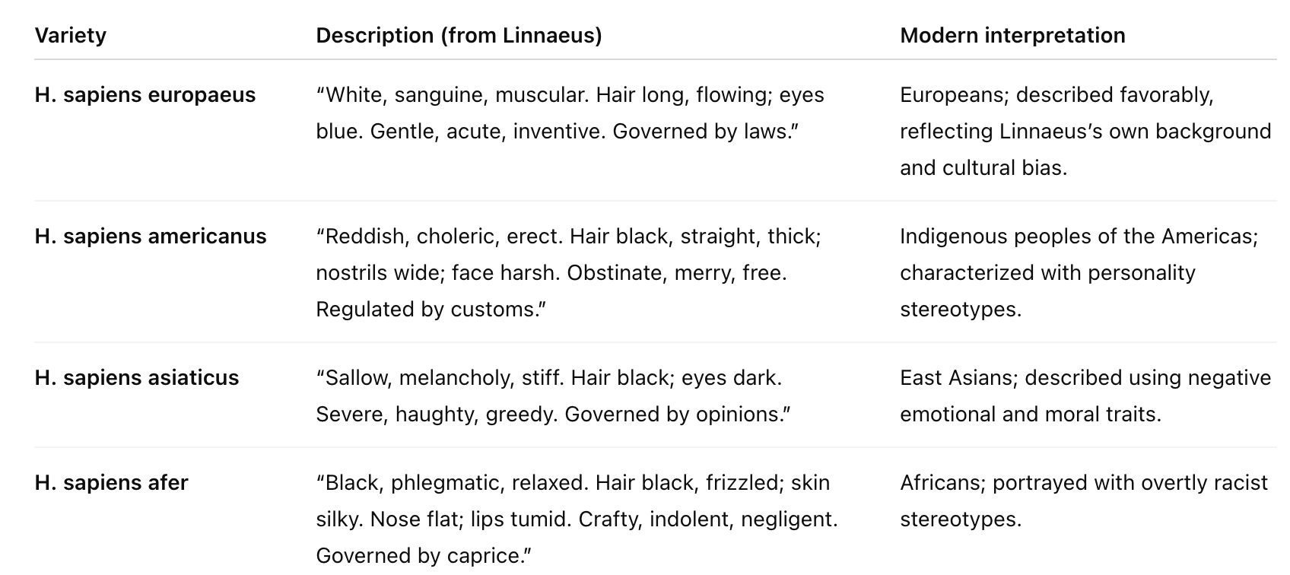
First Formal Classification of Humans
In his 1758 book, Systema Naturae, Carl Linnaeus divided Homo sapiens into four distinct “varieties”
You can see that the prejudice was already baked in.

Slide 9
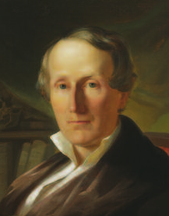
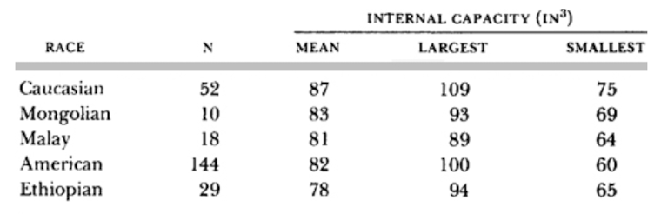
Skull Capacity
In an early attempt to quantify the differences between the races, Samuel George Morton set about measuring the skull capacities of various races, using mustard seeds.
Not surprisingly, they fell in line exactly as you would have expected
Stephen Jay Gould’s assessment is that Morton did not consciously bias the data, but likely stuffed the seeds a little more tightly in the White skulls, etc.

Slide 10
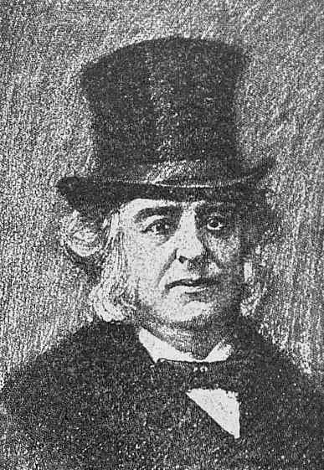
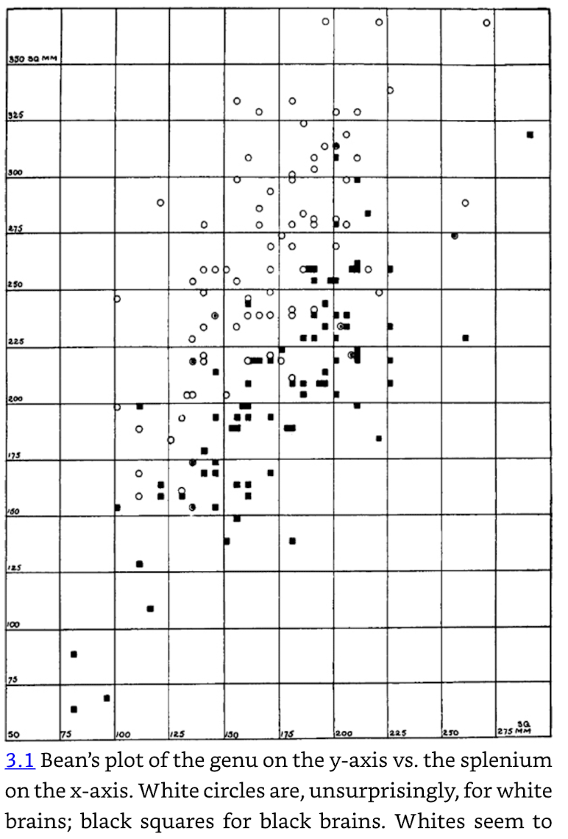
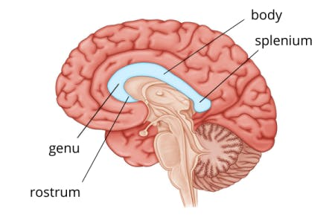
Measuring Skulls (cont’d)
Not content with simply measuring capacity, Paul Broca took detailed measurements of different parts of the brain.
In particular, the different parts of the corpus collosum.
Broca claimed that in superior people, the front part, or “genu”, relative to the back part, or “splenium”.
Not surprisingly, White people came out on top!

Slide 11
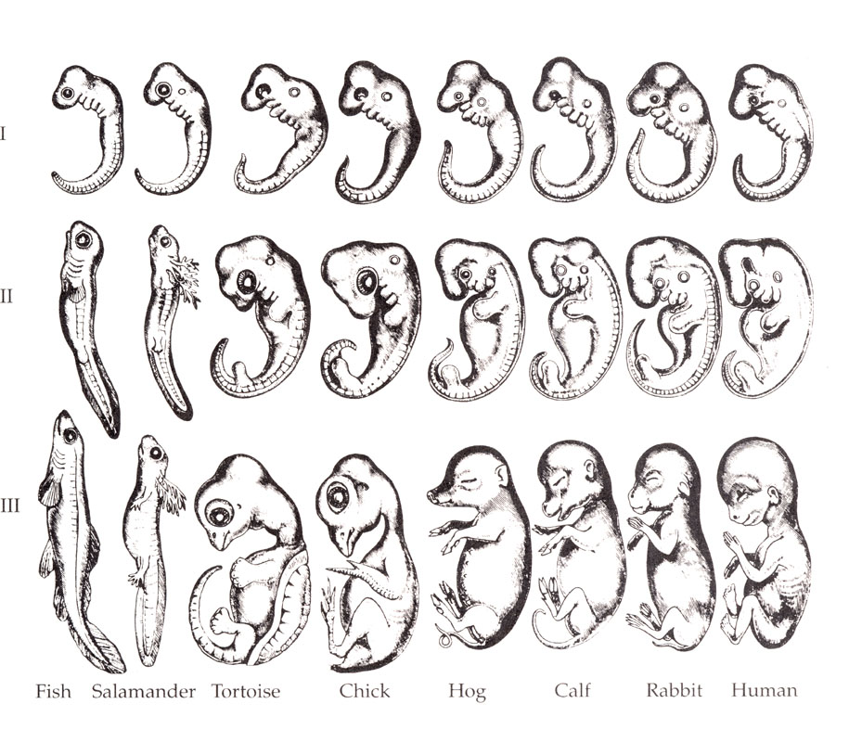
Recapitulation
Developed by Étienne Serres in the 1820s, based on the work of Johann Friedrich Meckel, this theory is based on the hypothesis that the development of an organism from embryo to adulthood (ontology) mirrors its evolution from its remote ancestors (phylogeny).
As applied to race science, it put forward the claim that adults of “inferior” races (Blacks, Asians, etc) resembled the children of “superior” races (i.e Whites).
People rushed to find pictures to support this hypothesis.
In 1926, Dutch anatomist Louis Bolk proposed “neoteny”, which held the exact opposite view; namely that the children of “superior” races were more similar to the adults of “inferior” races
And people rushed to find totally different pictures to support this hypothesis.

Slide 12
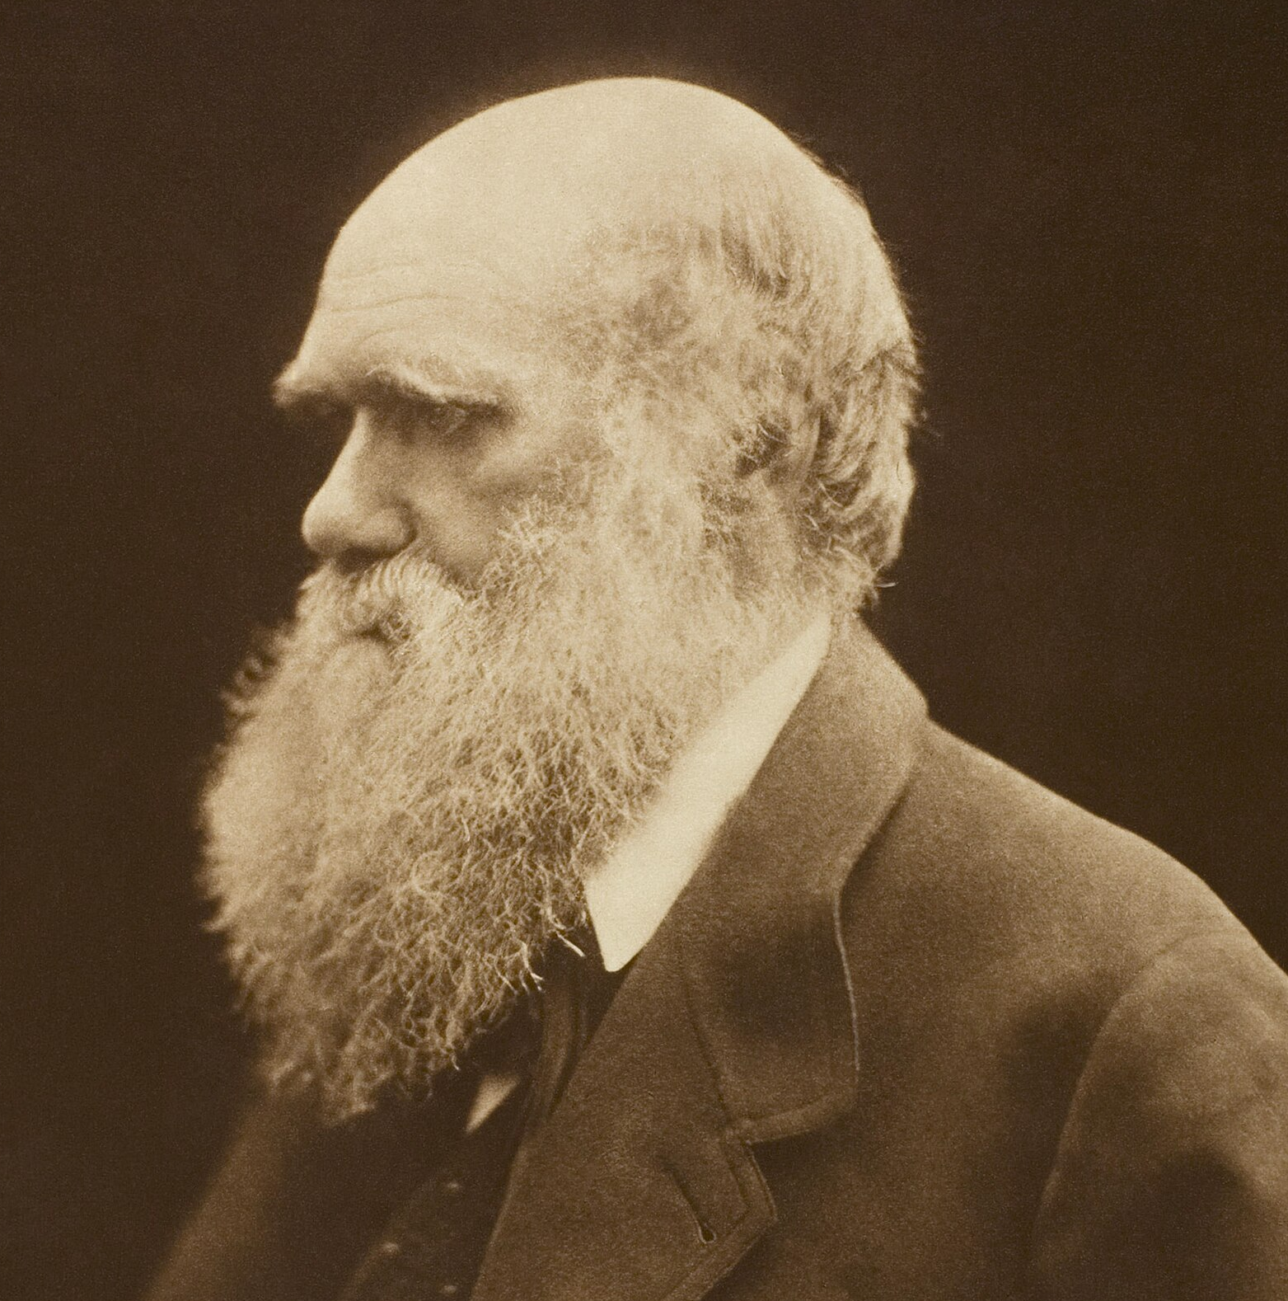
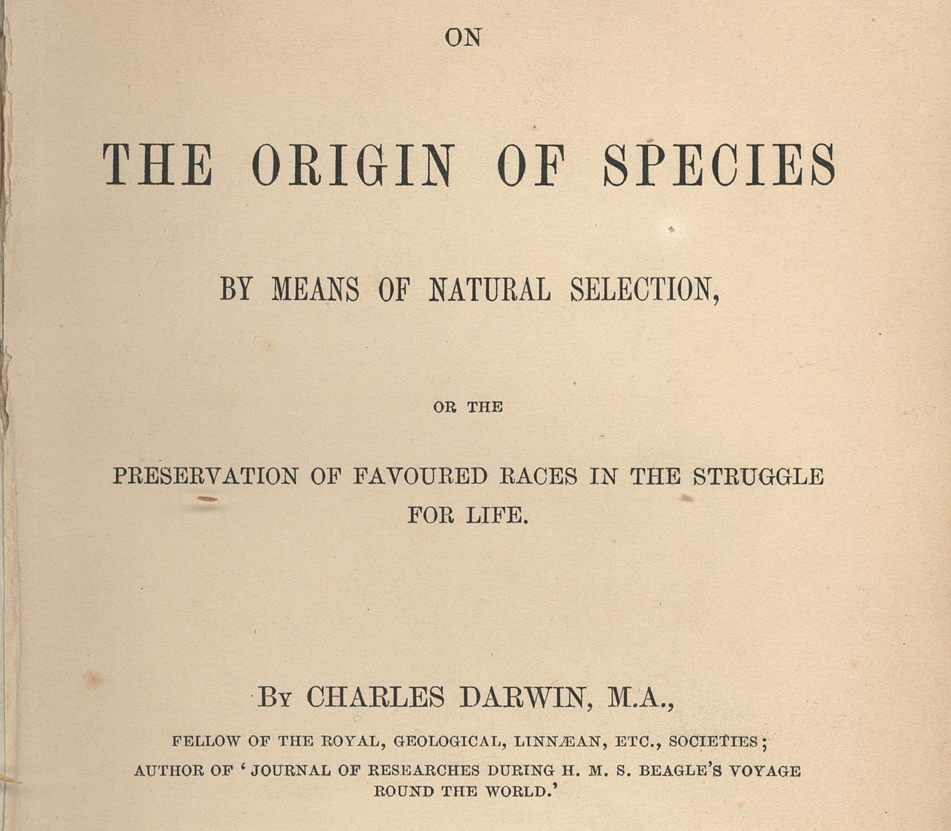
Enter Darwin
In 1859, Charles Darwin published “On the Origin of Species”
Full title: “On the Origin of Species by Means of Natural Selection, or the Preservation of Favoured Races in the Struggle for Life”
The basic tenets of his theory are that all animals, including humans, “evolve” based on the following tenets
Traits can be passed on from on generation to the next.
From time to time, random mutations introduce changes in organisms.
Changes that are advantageous to survival are “naturally selected”, in that the organisms that possess them are more likely to produce offspring.
This theory rocked the world and is the foundation of all modern biology.
Needless to say, it was also catnip to those interested in scientific racism.

Slide 13
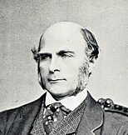
Francis Galton and “Eugenics”
Francis Galton was born to a wealthy family of gun-makers and bankers in Birmingham
i.e. “born on third base”.
He’s the half-cousin of Charles Darwin.
There is no question he was a prodigy, polymath, and a brilliant scientist
Made seminal contributions to meteorology, statistics (regression and correlation), psychology, biology (the nature and mechanism of heredity), and criminology (fingerprints).
What he’s mostly known for, however, is his belief that the human race could be “improved” through selective breeding.
Encouraging breeding by people deemed “superior”
Discouraging breeding by those deemed “inferior”
He put his beliefs in the book, Inquiries into Human Faculty and Its Development (1883), in which he coined the term “eugenics” to describe his belief.

Slide 14
Definition of Eugenics
Galton summed up the term as follows (emphasis mine)
“We greatly want a brief word to express the science of improving stock, which is by no means confined to questions of judicious mating, but which, especially in the case of man, takes cognizance of all influences that tend in however remote a degree to give the more suitable races or strains of blood a better chance of prevailing speedily over the less suitable than they otherwise would have had.”
Within this context, Galton actually held some progressive views.
He believed that ”superior stock” could in principle transcend existing social classes (but how often did it?)
Rejected traditional “racism”, at least at some level.
Still we’re back to the problem of reification.
What exactly did “improving the stock” mean?
He never really defined the term, as far as I (and ChatGPT) can tell.
He appears to taken it as axiomatic that the British aristocracy should serve as the ideal.

Slide 15
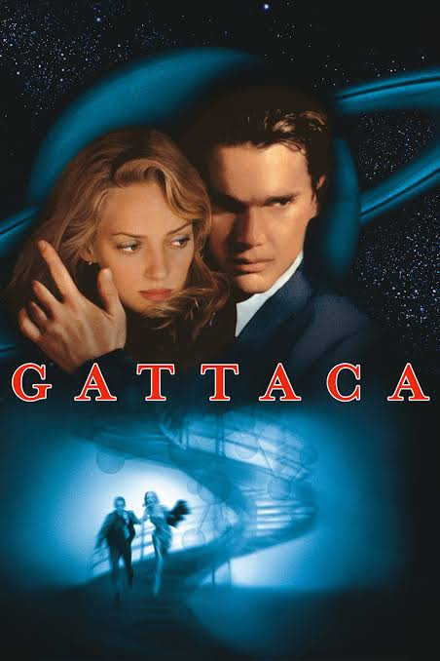
Digression: The Movie Gattaca
This 1997 movie imagined a world in which DNA testing has become 100% predictive.
Easily tested by a simple pin prick.
It’s therefore used as a the entire basis for a persons position in society:
The job they can hold
The person they can date
Who gets to to reproduce
Such a thing was of course the dream of the eugenicists.
Although they of course did not yet know about DNA
Obviously, things turn out to be a bit more complicated in the movie, just as they turn out to be in real life.

Slide 16
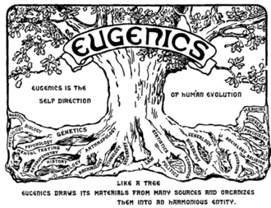
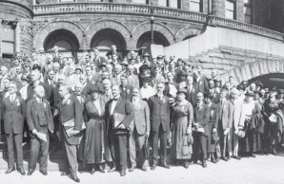
Spread of Eugenics and its Effects
Galton’s views took a while to catch on, but in the early 20th century, they took off with a vengeance.
Between 1903 and 1907, Eugenics Societies were formed in both the UK and the US.
Whereas Galton had prosed mostly voluntary breeding choices, with possibly incentives for breeding that built “good stock”, these societies quickly took a much darker turn.
They encouraged outlawing reproduction for “inferior people”, up to and including forced sterilization.
In 1907, Indiana became the first state to mandate forced sterilization for “confirmed criminals, idiots, imbeciles, and rapists”
Over 30 states followed suit!
In 1912, the first International Eugenics Conference was held in London.
Declared Eugenics a ”legitimate science”
Encouraged international eugenics policies, including forced sterilization and racial databases.

Slide 17
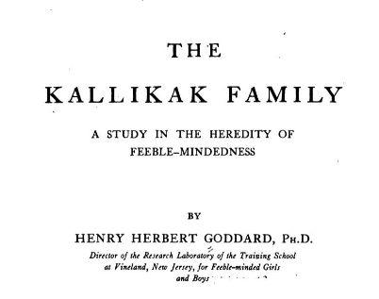
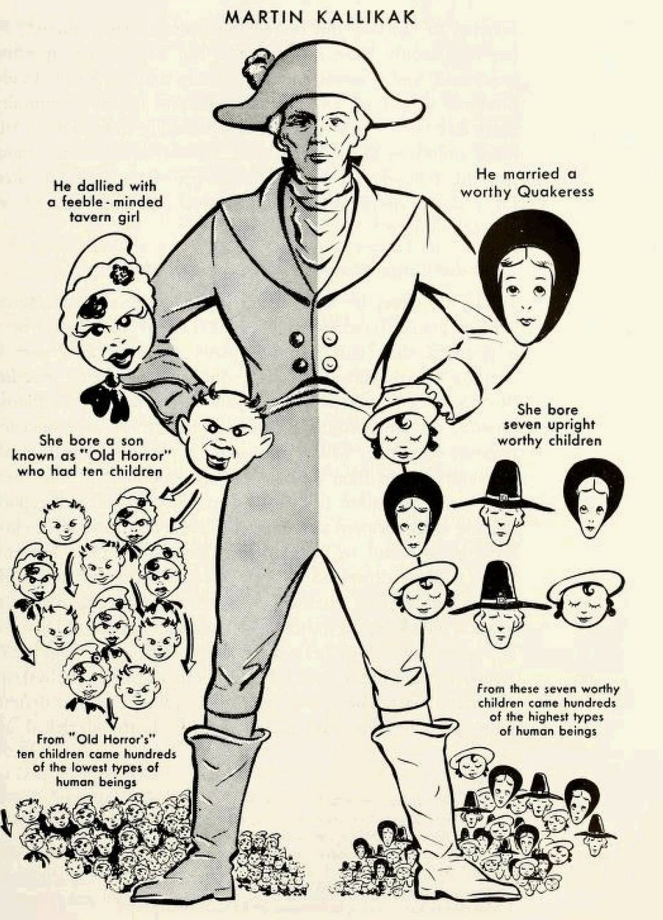
The Kallikak Family
One of the strongest pieces of “evidence” for eugenics was Henry Goddard’s 1912 study of the “Kallikak” family. It goes like this…
Martin Kallikak (a pseudonym) was a Revolutionary War hero, married to a Quaker woman.
On his way back from battle, he had a one-time dalliance with a “feeble-minded” barmaid, named Catherine Murray, whom he abandoned after she became pregnant.
Afterwards, he went back to his wife, mended his ways, and lived an upstanding life.
Both branches of his family produced several generations of descendants.
The assessment of the descendants of the “upstanding family” was that they all ended up prosperous, intelligent, and morally upstanding. They were lawyers, ministers, and doctors.
On the other hand, the descendants of his tryst with the barmaid ALL wound up poor, mentally ill, delinquent, and intellectually disabled, with her great-great-great granddaughter ending up in Goddard’s Home for the Education and Care of Feebleminded Children.
The story was taken as absolute proof of the hereditability of “desirable traits” and an absolute validation of eugenics.

Slide 18
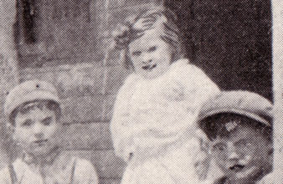
Kallikak Family (cont’d)
The problem is that it was all nonsense.
Research in 2001 concluded that the story was almost entirely fictitious.
First and foremost, Martin Kallikak never fathered an illegitimate child with the barmaid! The father was actually Gabriel Wolverton.
The child, and many of the descendants were actually quite successful.
Many of the unsuccessful ”descendants” were actually misidentified and had no relation to the “Kallikaks”.
The book went as far as to alter photgraphs to make the “bad Kallikaks” look more denerate.
The book is now regarded as complete nonsense, but for many years it was taken as gospel, and led to a lot of the horrors that followed…

Slide 19
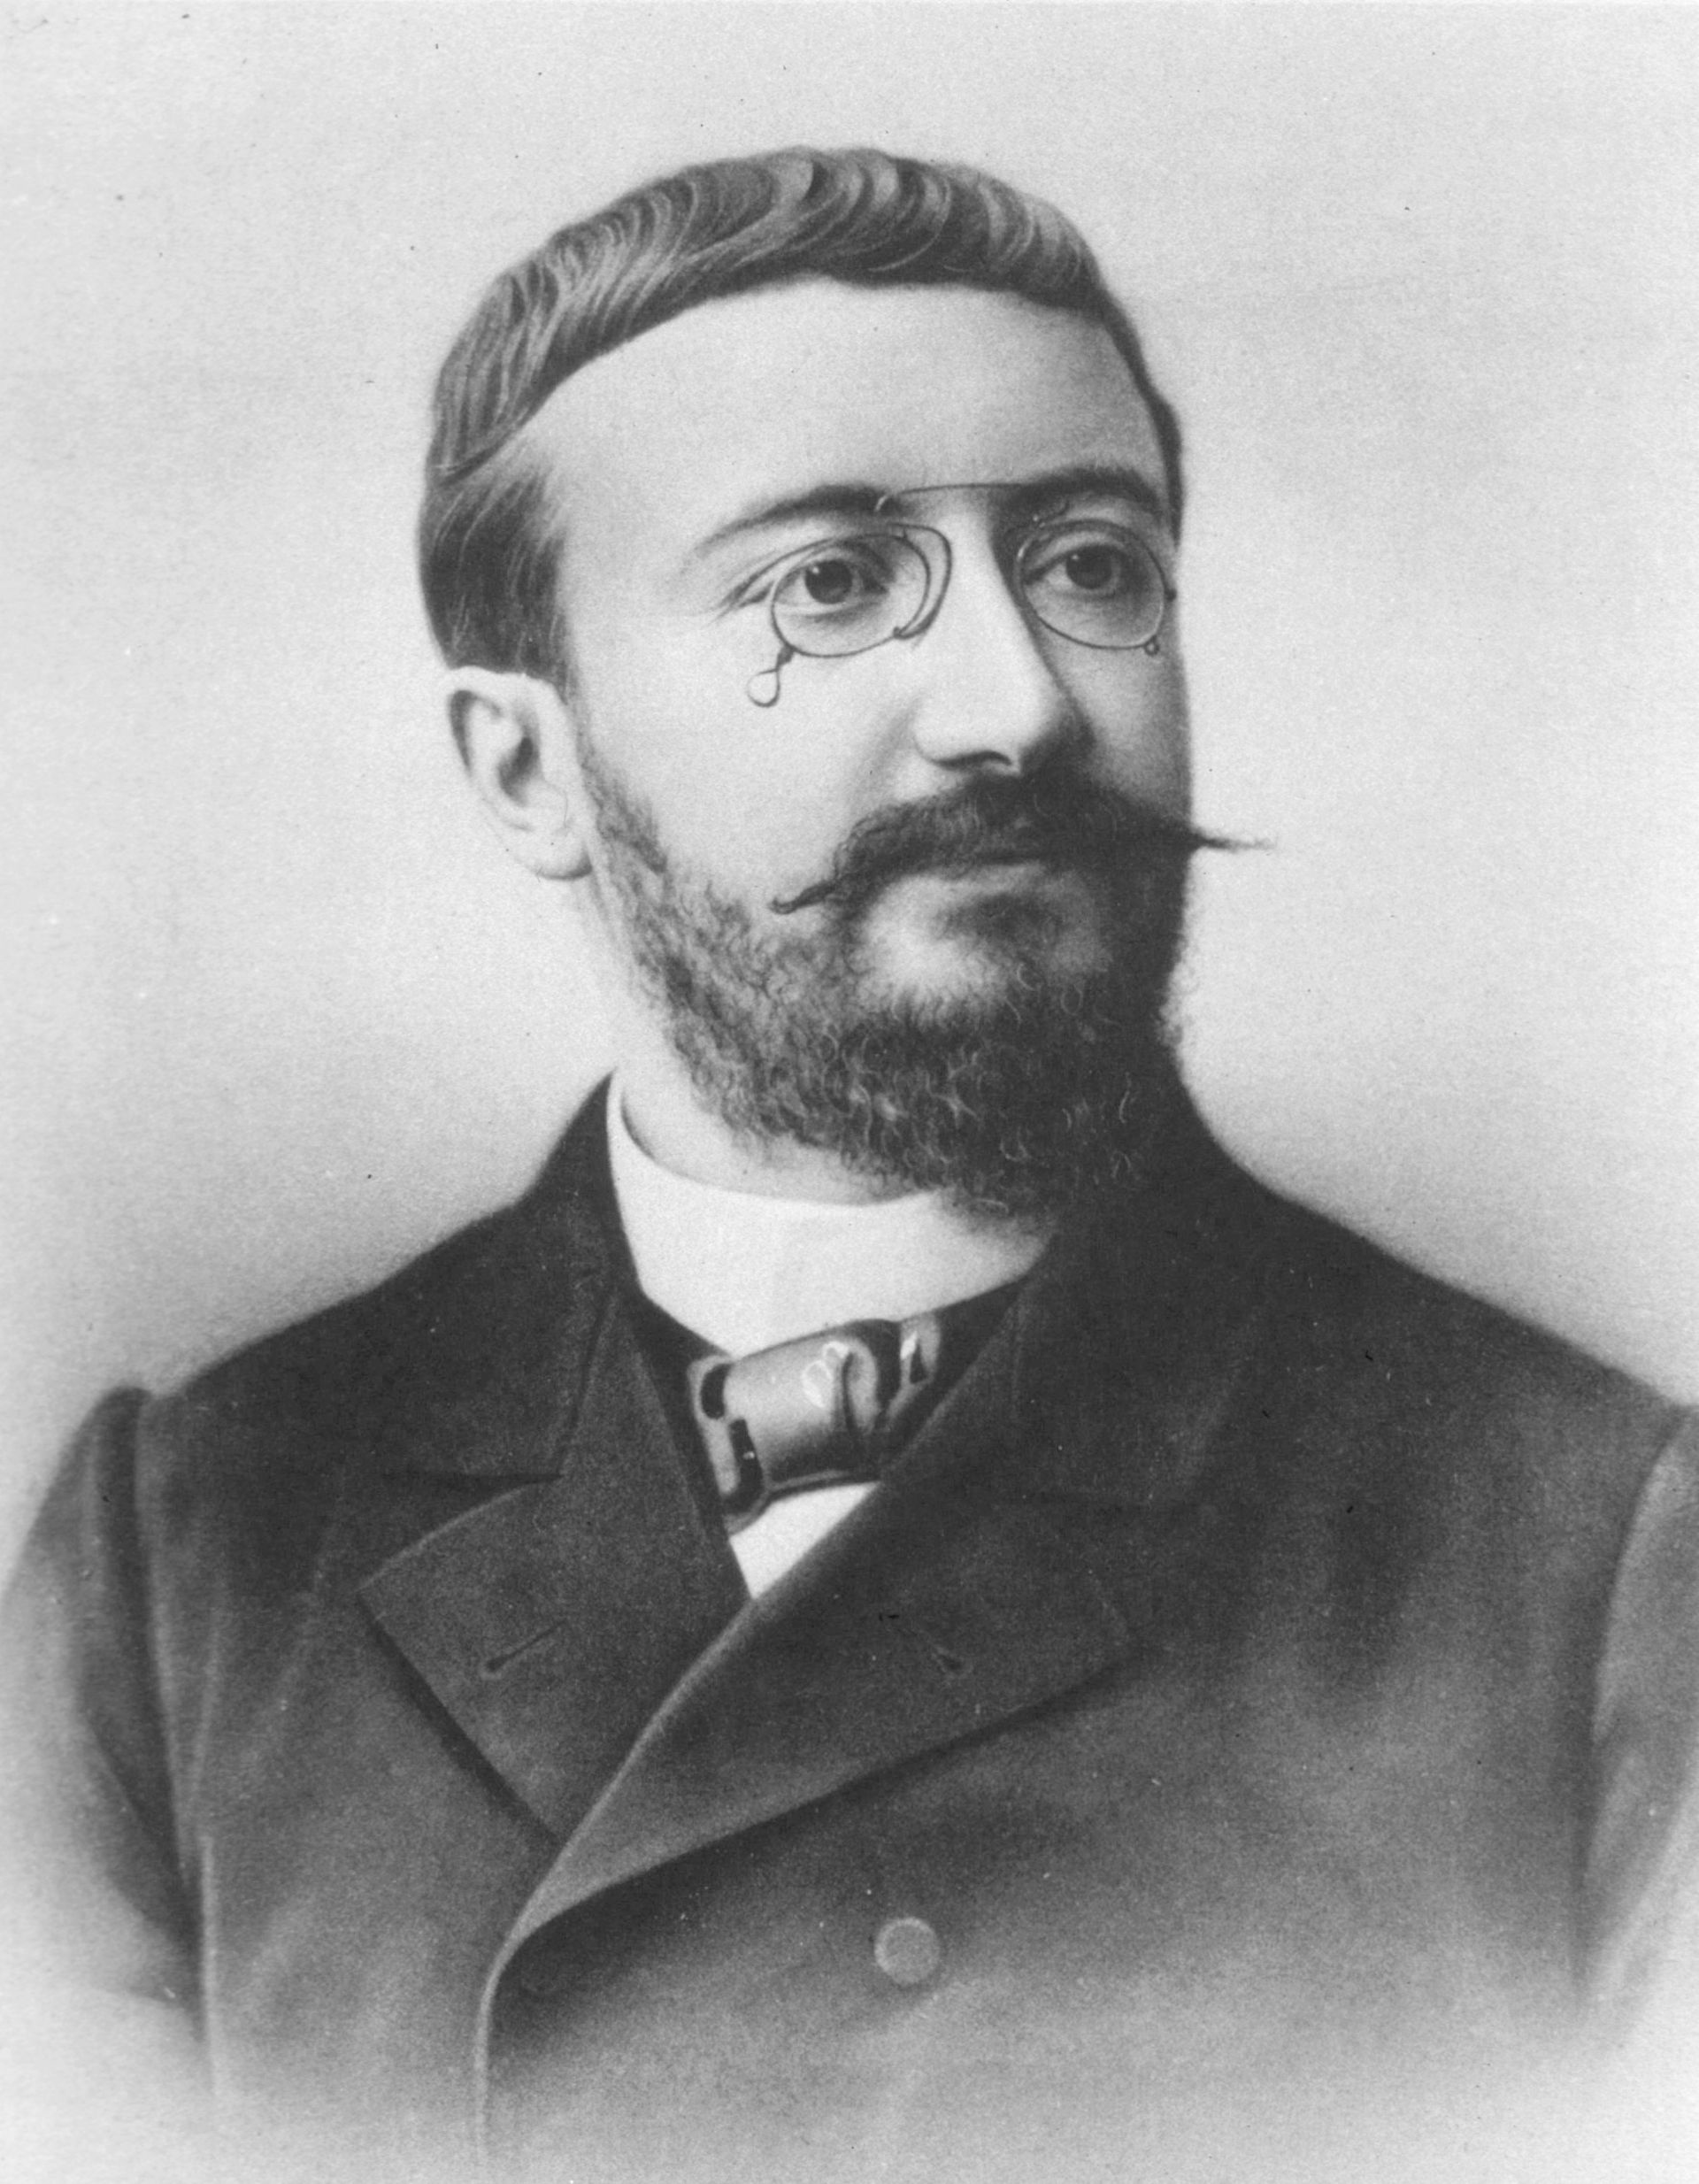
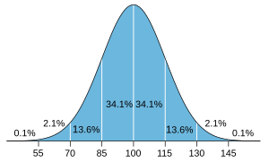
Intelligence Quotient (IQ)
There were numerous attempts to measure and quantify human “intelligence”, and interest grew with the advent of the eugenics movement.
In 1905, Alfred Binet and psychiatrist Théodore Simon created the “Binet–Simon Intelligence test”, which focused on verbal ability and reading comprehension.
They attempted to scale students’ “mental age” relative to their chronological age.
Binet himself acknowledged the multi-faceted nature of intelligence, and saw the test as a way to identify students who were having difficulties in school, so they could get the assistance they would need.
This eventually evolved into the Stanford-Binet Intelligence Scales, which is the most commonly used IQ test.
Nominally 100*(mental age)/(actual age)
In fact, scores are normalized to have a mean of 100 and a standard deviation of 15.

Slide 20
IQ and the Eugenics Movement
The concept of IQ spread through the Eugenics Movement like wildfire.
Unlike Binet, who saw the IQ test as a way to identify students who needed extra help, eugenicists saw the test as a measure of innate intelligence.
Suggested IQ should be used to determine placement in all aspects of society, including education placement, job eligibility, and even breeding decisions.
Early tests relied heavily on English language proficiency and also on familiarity with middle or upper class knowledge.
Example: an army IQ test used the word “regatta”, in spite of the fact many people taking it were not familiar with yacht races!
As a result, poor people, non-White people, and recent immigrants tended to perform poorly.
Along with things like the Kallikak “study”, this was used to support more restrictive immigration policies.

Slide 21
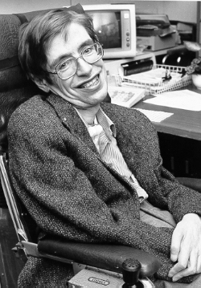
Validity of the IQ Test
Even with the racial and cultural biases of the IQ test removed, there’s still a question of what it actually measures.
IQ scores rose through the 20th century in the developed world (“Flynn Effect”), indicating that it was at least partially a measure of education and environment, rather than “innate intelligence”.
Correlation of IQ tests to academic performance have been measured to be about .5
Correlation with job performance range from .2 to .6, depending on the study and the type of job.
So it measures something, but certainly should not be used to determine one’s social ranking.
There are plenty of high-IQ people working menial jobs.
When asked about his IQ, Stephen Hawking famously said,
“I have no idea. People who boast about their IQ are losers”
For stories of people obsessed with their IQs, check out the podcast “My Year in Mensa”, by Jamie Loftus.
Back to the program…

Slide 22
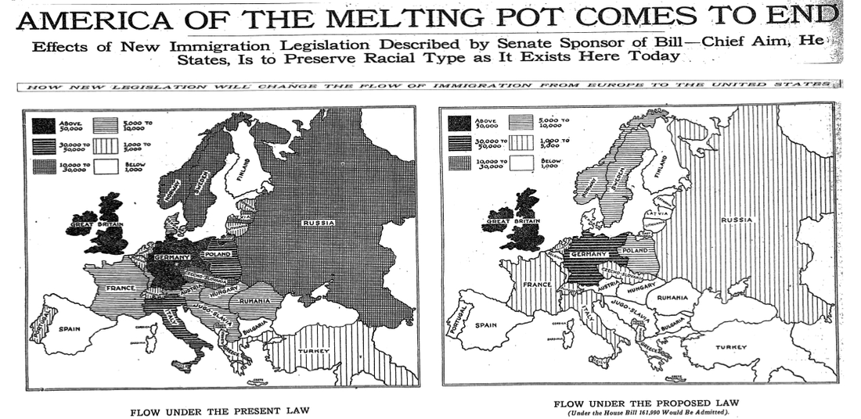
The 1924 U.S. Immigration Act (Johnson-Reed Act)
The Johnson Reed Act was the culmination of increasingly racist immigration laws passed since the late 19th century.
Those laws primarily focused on reducing Asian and African immigration, which had already been drastically curtailed by this time.
They were manifestly and unabashedly racist.
This bill focused on European immigration.
The difference is that NOW they had “science” on their side
Heavily influenced by eugenics.
Goddard’s study of the Kallikaks family was presented as evidence.
So were IQ scores.
Also head strong support by the Ku Klux Klan
In his speech to conference, Reed said that
”Immigrants from Southern and Eastern Europe, most of whom were Catholics or Jews, arrived sick and starving, were less capable of contributing to the American economy, and were unable to adapt to American culture.”
Quotas were set to preserve the racial profile at the time.
Heavily restricted Southern and Eastern European Immigration.

Slide 23
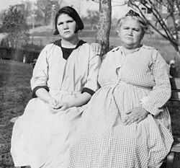
Buck v. Bell (1927)
Carry Buck was the illegitimate daughter of a prostitute, who was given up for adoption.
In her early teens, she gave birth to a child, and her adoptive family described her as “incorrigible”.
She was committed to the Virginia State Colony for Epileptics and Feebleminded., where her mother Emma was already incarcerated.
At 18, the superintendent, Alfred Priddy – a passionate eugenicist who had performed hundreds of sterilizations, wanted to sterilize her, using the argument that
She had the mental age of an 8-year-old
She “represented a genetic threat to society”.
Buck fought the case against John Bell, who succeeded Priddy as superintendents.
The case made it as far the Supreme Court, who upheld the sterilization.
Again, Goddard’s study of the Kallikaks family was presented as evidence.
Oliver Wendell Holmes Jr famously commented “Three generations of imbeciles are enough.”
After her sterilization, it was found
Her intelligence was in fact normal.
Her teen pregnancy was almost certainly the result of a rape by her adoptive mother’s nephew.
The family had her committed to cover up the truth.
In the end, approximately 70,000 forced sterilizations were carried out in the US alone.

Slide 24
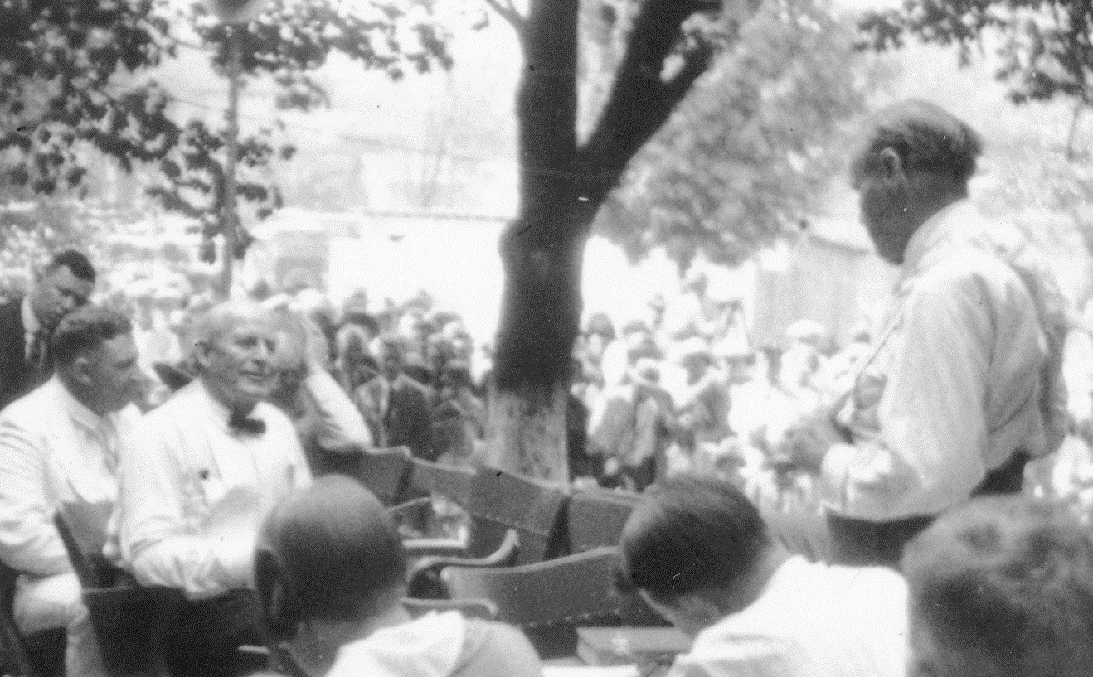
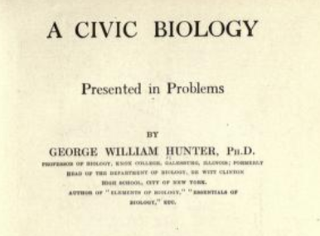
Scopes Monkey Trial (1925)
The “Scopes Monkey Trial” pitted Presidential candidate Williams Jennings Bryan against the legendary lawyer Clarence Darrow in a challenge to Ohio’s law against teaching evolution in the classroom.
It was immortalized in the excellent play and movie “Inherit the wind”.
The play was highly fictionalized. In fact, the entire thing was staged by the ACLU in full cooperation with the Dayton Chamber of Commerce
The ACLU wanted to challenge the law
The Chamber of Commerce wanted people to come to town.
What they always leave out of the story was that the textbook being defended was ”A Civic Biology: Presented in Problems”, by George Hunter, which was strongly pro-eugenics.
That was simply the prevailing view at the time in the US!

Slide 25
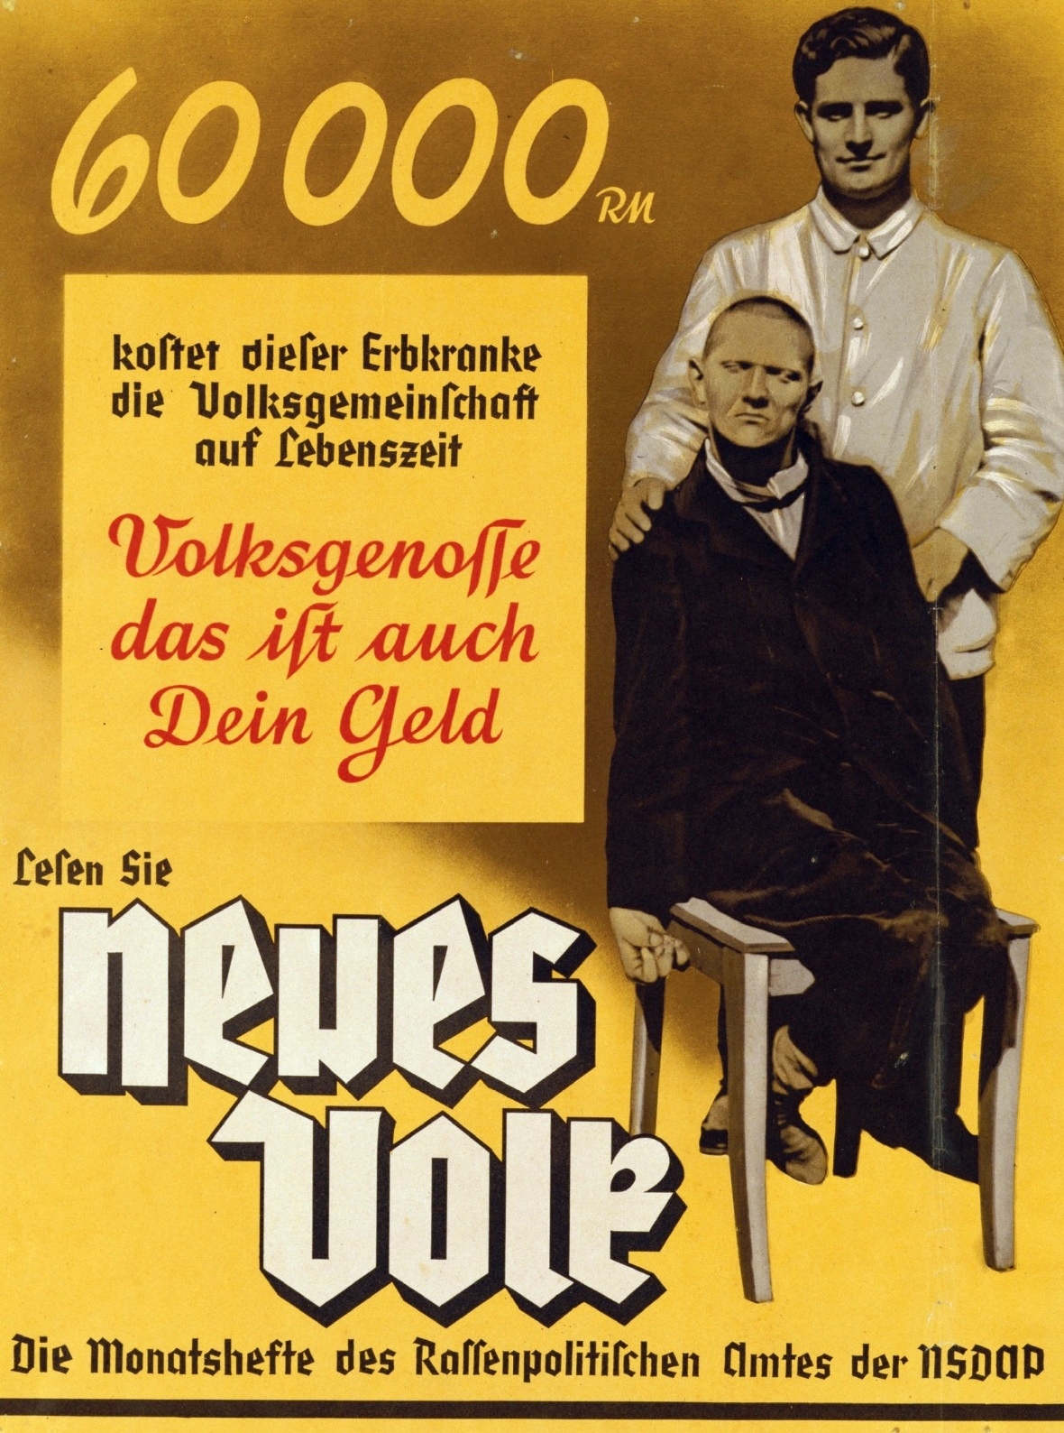
We All Know Where it Went…
In the 1930s, eugenics became a core component of the Nazi regime in Germany.
They referred to it as “racial hygiene”
This included a massive program of forced sterilization. Reasons included:
Hereditary diseases
Mental illness
“Inferior” races: Jews, Romani, Blacks, etc
Criminal or antisocial behavior
It was explicitly patterned after California’s forced sterilization program, which by 1933 had performed more forced sterilizations than all other US states combined.
Hitler learned about the US eugenics movement while in prison and became a big fan.
California eugenicist C. M. Goethe once bragged to a colleague
”You will be interested to know that your work has played a powerful part in shaping the opinions of the group of intellectuals who are behind Hitler in this epoch-making program. Everywhere I sensed that their opinions have been tremendously stimulated by American thought... ”
I hope I don’t need to tell you any more about how bad the Nazis were.
The opinions of some current “influencers” notwithstanding.

Slide 26
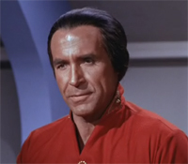
The Fall of Eugenics
In addition to the Nazis giving Eugenics a bad name, it was once again based on the flawed fallacy of reification, the notion that we could breed generically “superior” humans.
Part of the the Star Trek canon are the Eugenics Wars, which took place in the distant future of the mid 1990s.
They succeeded in breeding “superior humans” who were smarter, stronger, and more talented than everyone else.
They failed because of of infighting
In fact, eugenics is flawed because you can’t select for general superiority. Taking a cue from animal breeding
We breed racehorses for speed, not intelligence.
We breed chickens for lots of breast meat.
I’m not sure what the point of French bulldogs was.
The German selective breeding program was very good at breeding blonde, blue-eyed people*, but beyond that it was a failure.
In the US
Forced sterilization began to be phased out in the 1970s.
Continued in California prisons until 2010!
However, Buck v. Bell has never been overturned!
We can’t all be Kahn!
*Anni-Frid Lyngstad of ABBA is the result of this.

Slide 27
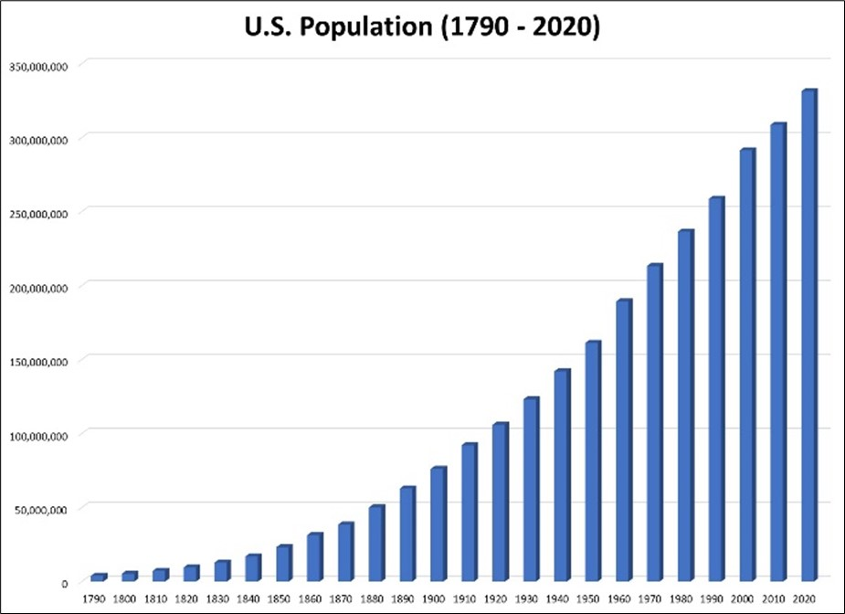
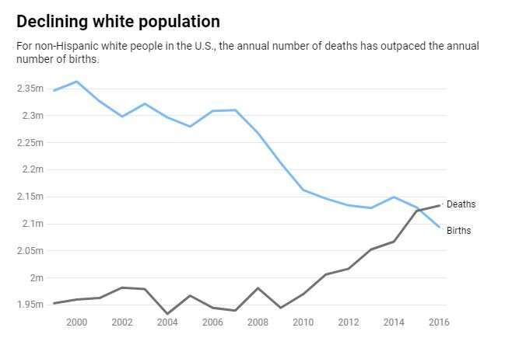
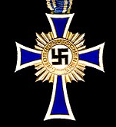
“Pronatalism” (eugenics by another name)
There is a of handwringing these days about the “declining birth rate” in the US, which you can obviously see from this plot*.
This has become a cause célèbre among Silicon Valley Oligarchs, particularly Elon Musk.
They carefully avoid the term “eugenics”, but say things like “smart people aren’t having enough babies”, which is the same thing.
Obviously, the graph that really bothers them is this one.
The have even discussed incentives for having children.
This has been tried before
Ehrenkreuz der Deutschen Mutter
*that was sarcasm

Slide 28
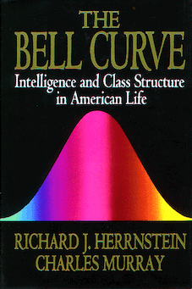
Everything Old is New Again…
Pronatalism is just one way that these ideas keep cropping up.
It’s just one aspect of “The Great Replacement” conspiracy theory, that “superior” Whites* are being replaced by “inferior” races.
In fact, these beliefs are having a heyday.
“The Belle Curve” in 1996 again brought up the idea that non-Whites were innately less intelligent than White, based on IQ tests.
This was discussed by Stephen Jay Gould in the preparation assignment.
Conclusions debunked by numerous experts.
Nevertheless, many still treat it as gospel.
In spite of overwhelming evidence of continuing implicit and explicit bias** in hiring, etc, efforts to ameliorate the situation are now being portrayed as antithetical to “merit”.
*Tucker Carlson prefers the term “Legacy Americans”.
**If you don’t believe me, take a test yourself.

Slide 29
Some Things to Think About…
Attempts at eugenics through selective breeding are fundamentally flawed
Whatever individual traits may be selected for are canceled by the problems related to reducing genetic diversity.
However, it won’t be long before we’ll be able to perform gene editing, enabling us to select arbitrary traits at the genetic level. We’ll literally be able to choose from a menu of:
Musical ability
Mathematical ability
Athletic ability
Appearance
Etc.
The ethical implications of this are daunting.

